Slide 1

KIF: Knowledge in Frame
Claude Roux
Parsing and Semantics Group
Xerox Internal Use Only – Xerox Confidential – Xerox Third Party Confidential – Xerox Personal Confidential

Slide 2

KIF (Knowledge In Frame)?
A little bit of history…
→ Parsers tend to have a golden fish memory…
    But sometimes, you need to remember stuff…
    Such as: a rule did apply, and we know this string to be…
    Let’s implement variables…
    and Hell broke loose…
Page <number>
Xerox Internal Use Only – Xerox Confidential – Xerox Third Party Confidential – Xerox Personal Confidential

Slide 3

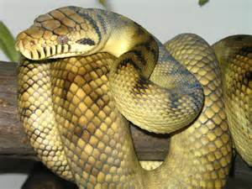
Python
Variables are not enough…
Why not functions, containers? into the fabric of XIP rules…
Let’s use Python…
Alas… It bites back…
Binary issues…
Debugging issues…
String issues…
Page <number>
Xerox Internal Use Only – Xerox Confidential – Xerox Third Party Confidential – Xerox Personal Confidential

Slide 4

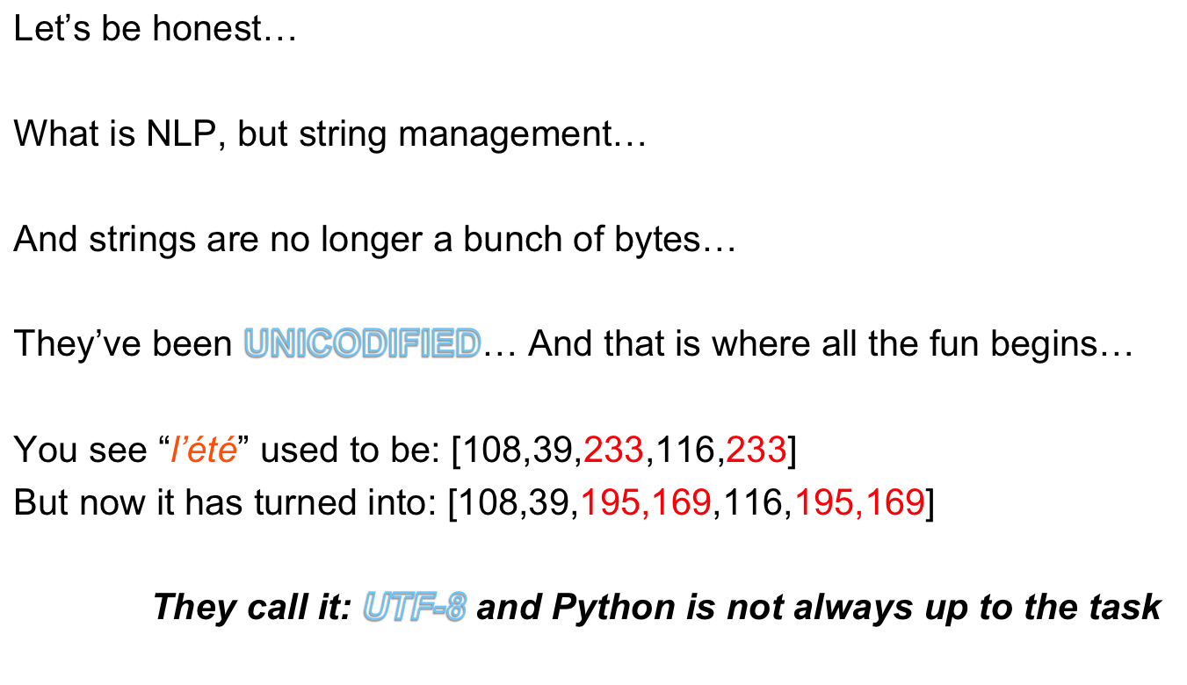
My name is 8… UTF-8
Page <number>
Xerox Internal Use Only – Xerox Confidential – Xerox Third Party Confidential – Xerox Personal Confidential

Slide 5

What do we need?
We need a language with a strong, very strong emphasis on string handling…
You should be able to handle a string without wondering what its encoding is.
      It should not crash when a string is a mongrel born out of encoding inter-mixing…
You should be able to tokenize a string, split it, extract things from it, apply regular expressions, BNF grammars… You should have access to the full weaponry in the art of string handling.
Whatever this string is encoded into…
Page <number>
Xerox Internal Use Only – Xerox Confidential – Xerox Third Party Confidential – Xerox Personal Confidential

Slide 6
Is such a language possible?
YES…
^{Knowledge in Frame… KiF}
Page <number>
Xerox Internal Use Only – Xerox Confidential – Xerox Third Party Confidential – Xerox Personal Confidential

Slide 7
KiF
It comes with many different flavors:
Windows
Linux
Mac OS
It is multi-threaded, and has its own multi-platform graphical user interface.
It can also be extended with external libraries:
SQLite, Curl,
Page <number>
Xerox Internal Use Only – Xerox Confidential – Xerox Third Party Confidential – Xerox Personal Confidential

Slide 8
Programmation
KIF est un langage de programmation proche de Python
  En revanche, l’interprétation d’une variable dépend de son contexte
KIF impose que chaque variable doit être déclarée avec un type particulier:
    string, float, int, boolean, map, vector, xml, time, fst, node ou dependency.
    Les classes sont appelées frame.
Page <number>
Xerox Internal Use Only – Xerox Confidential – Xerox Third Party Confidential – Xerox Personal Confidential

Slide 9
Premier programme
//On declare une variable de type string…
string s=“12”;
//We display its content.
print(“S=“+s,”\n”);
Run
S=12
Page <number>
Xerox Internal Use Only – Xerox Confidential – Xerox Third Party Confidential – Xerox Personal Confidential

Slide 10
Second programme
//Déclaration d’un entier
int i=10;
i=s+i; //the s is automatically converted into a number.
print(“I=“+i+”\n”);
Run
I=22
Page <number>
Xerox Internal Use Only – Xerox Confidential – Xerox Third Party Confidential – Xerox Personal Confidential

Slide 11
Déclaration de fonctions
Les fonctions sont déclarées dans KIF avec le mot clef: function.
KIF est sensible à la casse
Une function doit être déclarée avec ses paramêtres
Exemple:
function display(string s) {
print(“S=“+s+endl);
}
display(“toto”);
Run
S=toto
Page <number>
Xerox Internal Use Only – Xerox Confidential – Xerox Third Party Confidential – Xerox Personal Confidential

Slide 12
Déclaration de classe: frame
Une classe ou frame se déclarle avec le mot clef: frame.
Il contient variables et fonctions.
On peut aussi declarer une sous-classe dans une frame.
Les fonctions peuvent être redéfinies dans une sous-classe
Les variables de classe peuvent être initialisées dans la frame.
On peut aussi déclarer un constructeur: initial.
Page <number>
Xerox Internal Use Only – Xerox Confidential – Xerox Third Party Confidential – Xerox Personal Confidential

Slide 13
Example
frame myframe {
int i=10; //every new frame will instantiate i with 10
string s=“initial”;
vector myvect;
function display() {
print(“IN MYFRAME:”+s+”\n”);
}
frame mysubframe {
function display() {
print(“IN MYSUBFRAME:”+s+”\n”);
}
}
}
Page <number>
Xerox Internal Use Only – Xerox Confidential – Xerox Third Party Confidential – Xerox Personal Confidential

Slide 14
Utilisation d’une frame
Declaration
Calling a frame’s function
myframe instance; //we create a frame
mysubframe subinstance; //we create a sub-frame
instance=myframe; //we create a new instance of that frame
instance.display();
subinstance.display();
Run
IN MYFRAME:initial
IN MYSUBFRAME:initial
Page <number>
Xerox Internal Use Only – Xerox Confidential – Xerox Third Party Confidential – Xerox Personal Confidential

Slide 15
Initial
_initial est le constructeur d’une frame.
Elle est déclarée comme une function normale:
Example
frame frm {
function _initial(int i) {…}
}
frm toto (10); //Declaration
toto=frm(100); //New instance
Page <number>
Xerox Internal Use Only – Xerox Confidential – Xerox Third Party Confidential – Xerox Personal Confidential

Slide 16
Différents objets
KIF fournit une famille d’objets dont certains sont spécifiques à XIP
Objet universel:
    self
Objets de base:
    string, int, float, boolean, time, call
Conteneurs:
    vector, map, matrix,file, iterator
Objets XIP:
    node, dependency, xml, fst, rule.
Page <number>
Xerox Internal Use Only – Xerox Confidential – Xerox Third Party Confidential – Xerox Personal Confidential

Slide 17
self
self correspond à un objet universel, mais qui fonctionne aussi comme une sorte de pointeur. On peut ainsi modifier un objet.
function initialise(self x) {
x=‘test’;
}
string v=‘toto’;
initialise(v);
v vaut ‘test’
Page <number>
Xerox Internal Use Only – Xerox Confidential – Xerox Third Party Confidential – Xerox Personal Confidential

Slide 18
string
Complètement agnostique pour l’encodage…
Methods:
size(): return the length of a string
ord(): return the code of a string character. Send either the code of the first character or a list of codes, according to the type of the receiving variable.
split(string splitter,vector vect): split a string along splitter and store the results in a vector. If splitter==“”, then the string is split into a vector of characters
removefirst(int nb): remove the first nb characters of a string
removelast(int nb): remove the last nb characters of a string
left(int nb): return the first nb characters of a string
right(int nb): return the last nb characters of a string
mid(int pos,int nb): return the nb characters starting at position pos of a string
pop(i): remove character at position i
pop(): remove last character
last(): return last character
insert(i,s): insert the string s at I
Page <number>
Xerox Internal Use Only – Xerox Confidential – Xerox Third Party Confidential – Xerox Personal Confidential

Slide 19
String II
Methods:
trim(): remove the trailing characters
upper(): Return the string in upper characters
lower(): Return the string in lower characters
latin(): convert an UTF8 string in LATIN
utf8(): convert a LATIN string into UTF8
replace(rgx,str): Replace the substrings matching rgx with str
boolean=regex(rgx): Test if the regular expression rgx applies to string
vector=regex(rgx): Split the string along the regular expression rgx
string=regex(rgx): Return the substring matching rgx in the string
int=regex(rgx): Return the position of the substring matching rgx in the string
Operator
sub in s: test if sub is a substring of s
+: concatenate two strings.
Indexes
str[i]: return the i^{th} character of a string
str[i:j]: return the substring between i and j.
Page <number>
Xerox Internal Use Only – Xerox Confidential – Xerox Third Party Confidential – Xerox Personal Confidential

Slide 20
int, float
Methods:
log(),ln, exp,sqrt,tan,sin,cos,atan: different mathematical functions
chr(): return the ascii character corresponding to this number as a code.
Operators
+,-,*,/: mathematical operators
<<,>>: bitwise operators
%: division modulo
^: power
Page <number>
Xerox Internal Use Only – Xerox Confidential – Xerox Third Party Confidential – Xerox Personal Confidential

Slide 21
vector, svector, ivector, fvector
Compatible JSON
Methods:
size(): return the length of the vector
json(): renvoie le vecteur en format JSON
push(a): add a to the vector
pop(int i): remove the ith element from the vector and return it.
pop(): remove the last element from the vector and return it.
last(): return the last element of the vector
join(string sep): concatenate each element in the vector in a string where each element is separated from the others with sep
insert(i,x): insert the element x at position i
sum(): Sum each element with the others
product(): Multiply each element with the others
clear(): clean the vector
sort(compare): sort the content of the vector according to compare function.
apply(a,b,c…): apply all XIP rules store in the vector, passing a,b,c etc. as parameters.
Page <number>
Xerox Internal Use Only – Xerox Confidential – Xerox Third Party Confidential – Xerox Personal Confidential

Slide 22
vector, svector, ivector, fvector
Operator
x in vect: return true or a list of indexes, according to the receiving variable.
+,*,-,/ etc..: add etc.. a value to each element of a vector or add each element of vector to another
&&,||: intersection or union of two vectors
Indexes:
str[i]: return the i^{th} character of a vector
str[i:j]: return the sub-vector between i and j.
As an integer or a float
    Return the vector size
Initialisation
    A vector can be initialised with a structure between “[]”.
    vector v=[1,2,3,4,5];
Page <number>
Xerox Internal Use Only – Xerox Confidential – Xerox Third Party Confidential – Xerox Personal Confidential

Slide 23
map, imap, fmap, mapi,mapf etc. treemap, itreemap, etc.
Store any objects with a key. This key is always a string. Thus, “1” has the same key as 1. Compatible JSON
Methods:
size(): return the length of the vector
json(): renvoie une structure JSON du map
sum(): Sum each element with the others
product(): Multiply each element with the others
pop(string key): remove the elements matching key
clear(): clean the vector
Operator
x in amap: return true or a list of indexes, according to the receiving variable.
IMPORTANT: X is compared to the values stored in the map
+,*,-,/ etc..: add etc.. a value to each element of a map or add each element of a map to another along keys
&&,||: intersection or union of two maps along keys.
italian_ntm.grm
Page <number>
Xerox Internal Use Only – Xerox Confidential – Xerox Third Party Confidential – Xerox Personal Confidential

Slide 24
map
Indexes:
str[key]: return the element whose key is key
    As an integer or a float
      Return the size of the map
Initialisation
A map can be initialised with a description such as: {“a”:1,”b”:2}
map toto= {“a”:1,”b”:2};
italian_ntm.grm
Page <number>
Xerox Internal Use Only – Xerox Confidential – Xerox Third Party Confidential – Xerox Personal Confidential

Slide 25
iterator, riterator
Iterate on any objects of type: string, vector or map, rule.
riterator is the reverse iterator, to iterate from the end of the collection.
Instantiation: it consists in affecting an iterator with any objects of the above type.
Methods:
value(): return the value of the current element
key(): return the key of the current element
valuetype(): return the value type of the current element
isvaluetype(string type): test the type of the current element
begin(): initialiaze the iterator with the beginning of the collection
next(): next element in the collection
end(): return true when the end of the collection is reached
nend(): return true while the end of the collection has not been reached (~end())
apply(a,b,c): apply a XIP rule
Page <number>
Xerox Internal Use Only – Xerox Confidential – Xerox Third Party Confidential – Xerox Personal Confidential

Slide 26
file
Methods:
openwrite(string filename): open a file in write mode (aussi file f(chemin,’w’))
openread(string filename): open a file in read mode (file f(chemin,’r’))
write(string s1,string s2,…): write strings in the file
get(): read one character from the file
unget(): return one character to the stream
unget(nb): return nb character to the stream
read(): read a line from a file
readln(): read a line from a file
seek(int p): position the file cursor at p
tell(): return the position of the file cursor
eof(): return true when the end of file is reached
Operator
  x in file: if x is a string, then it receives a line from the file, if it is a vector, it pushes the line on the top of it. If x is an integer or a float, it gets only one character from the stream.
Page <number>
Xerox Internal Use Only – Xerox Confidential – Xerox Third Party Confidential – Xerox Personal Confidential

Slide 27
Un fichier est décomposé en “token”
function testreadafile(string path) {
file f;
f.openread(path);
string s;
vector words;
iterator it;
//Using the in operator
while (s in f) {
s=s.trim();
words=s.tokenize();
}
f.close();
}
Page <number>
Xerox Internal Use Only – Xerox Confidential – Xerox Third Party Confidential – Xerox Personal Confidential

Slide 28
node: Syntactic XIP node
Methods:
name(): return the part of speech
data(map feats): Features are stored in map as attribute/value
setfeature(string att, string val): feature assignment to the node
feature(string att): return the value of an attribute
feature(string att,string val): test the value of an attribute
next(): return the next node after current node
previous(): return the previous node after current node
child(): return the first child node under current node
last(): return the last child node under current node
parent(): return the parent node above current node
surface(): return the surface string
lemma(): return the lemma string
Page <number>
Xerox Internal Use Only – Xerox Confidential – Xerox Third Party Confidential – Xerox Personal Confidential

Slide 29
JSON
//on déclare un parseur
parser francais(_paths[1]+'\agenda.grm');
//On rajoute l’option XIP_JSON
francais.addoption(XIP_JSON);
vector v=francais.parse(‘Ceci est un exemple’);
println(v);
Page <number>
Xerox Internal Use Only – Xerox Confidential – Xerox Third Party Confidential – Xerox Personal Confidential

Slide 30
Ajouter des règles
function appel(dependency d) {
println(d.name(),d.features());
}
string règle=@”
Script:
if (subj$1(#1,#2)) {
appel($1);
}
“@;
parser francais(_paths[1]+'\agenda.grm');
francais.addendum(règle,true);
Page <number>

Slide 31
xml: XML nodes
Methods:
name(): return the XML node name
data(map props): Properties are stored in map as attribute/value
next(): return the next XML node
previous(): return the previous XML node
child(): return the first child node under current node
parent(): return the parent node above current node
As a string
    Return the XML node name
Page <number>
Xerox Internal Use Only – Xerox Confidential – Xerox Third Party Confidential – Xerox Personal Confidential

Slide 32
node: Syntactic XIP node II
Methods:
number(): return the ID of current node
offset(int left,int right): left and right receive the offset
offsetchar(int left,int right): left and right receive the character offset
tokenoffset(int left,int right): left and right receive the token offset
xmlnode(): return the XML node associated with this node (TOKENIZE mode)
As a string
    Return the Part of Speech
As an integer or a float
    Return the node ID
Page <number>
Xerox Internal Use Only – Xerox Confidential – Xerox Third Party Confidential – Xerox Personal Confidential

Slide 33
dependency: Syntactic XIP dependency
Methods:
name(): return the dependency name
data(map feats): Features are stored in map as attribute/value
setfeature(string att, string val): feature assignment to the dependency
feature(string att): return the value of an attribute
feature(string att,string val): test the value of an attribute
parameters(): return a vector of node variable
stack(vector v): return the dependency stack in a vector of strings
push(string s): push s on the dependency’s stack
pop(int i): remove the i^{th} element from the dependency’s stack
pop(): remove the last element on top of the dependency’s stack
As a string
    Return the dependency name
As an integer or a float
    Return the dependency ID
yntactic XIP node
Page <number>
Xerox Internal Use Only – Xerox Confidential – Xerox Third Party Confidential – Xerox Personal Confidential

Slide 34
Utiliser XIP dans KiF: parser
XIP est exporté dans KiF sous le nom parser.
Il existe deux façons de gérer les résultats de XIP dans KiF:
  A) Via un objet JSON
  B) en rajoutant de règles XIP de façon dynamique…
Page <number>
Xerox Internal Use Only – Xerox Confidential – Xerox Third Party Confidential – Xerox Personal Confidential

Slide 35


BUGS…
Aucun bien sûr…
Page <number>
Xerox Internal Use Only – Xerox Confidential – Xerox Third Party Confidential – Xerox Personal Confidential

